Slide 1
Final Project Check-In
Ella Zaputil
BAIS:3250 Data Wrangling
Professor Redmond
27 April 2025

Slide 2
The Data
Source 1
Downloaded “IMDB Movies Dataset” from Kaggle
1,000 data points from this source
Source 2
Scraped data from The Numbers movie database website
3,800 data points from this source
Integrated Data
Horizontally integrated data on Movie Title and Release Year
Inner joined data to keep only data that matched from source 1
314 data points for my final analysis

Slide 3
Data Dictionary
Feature | Data Type | Description
Movie Title | Object | Title of film
Release Year | Integer | Year film was released
Runtime | Integer | Length of film in minutes
IMDB Rating | Float | Rating of film on IMDB website
Director | Object | Director of film
Star 1-4 | Object | Names of top 4 cast members in film
Genres | Integer | Column for each genre, 0 or 1
Ranking | Integer | Ranking of film
Release Date | DateTime | Date of film release
Production Budget | Integer | Production budget of film
Domestic Gross | Integer | Gross revenue in country of filming
Worldwide Gross | Integer | Gross revenue of film internationally

Slide 4
Initial Analysis
Research Questions
How does a film’s production budget impact its gross revenue?
Do certain actors consistently produce higher-grossing films?
How does release timing impact gross revenue?

Slide 5
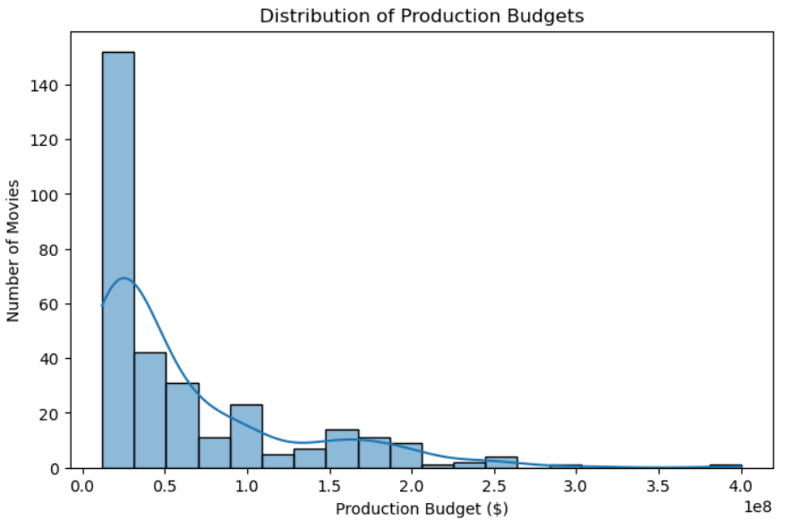
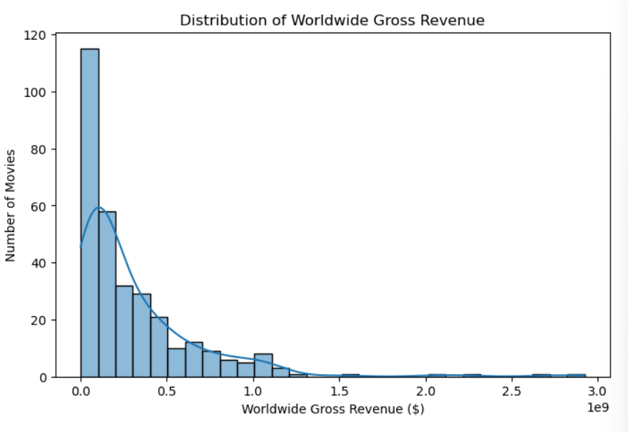
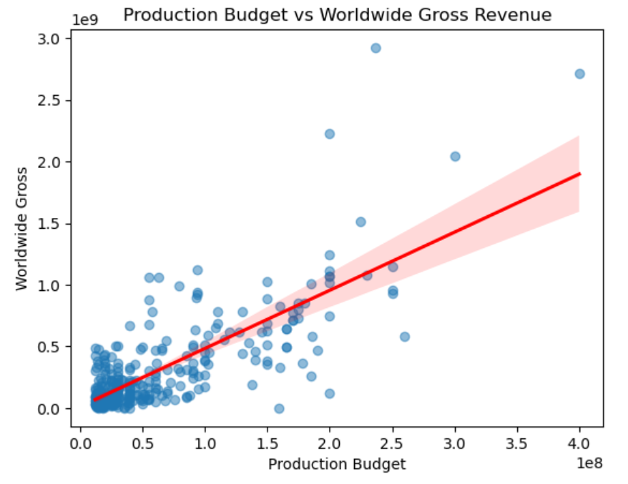
How does a film’s production budget affect gross revenue?
Methodology
Univariate Analysis - distribution of Production Budget and Worldwide Gross Revenue, separately
Bivariate Analysis - created scatter plot to visualize relationship and found correlation between 2 variables
Machine Learning - ran linear regression between 2 variables
Results
Both variables are right-skewed in their distributions
Positive relationship between Production Budget and Worldwide Gross Revenue
Correlation = 0.77
R-Squared = 0.59
Linear Regression Equation = 12176232.57 + 4.7122x

Slide 6
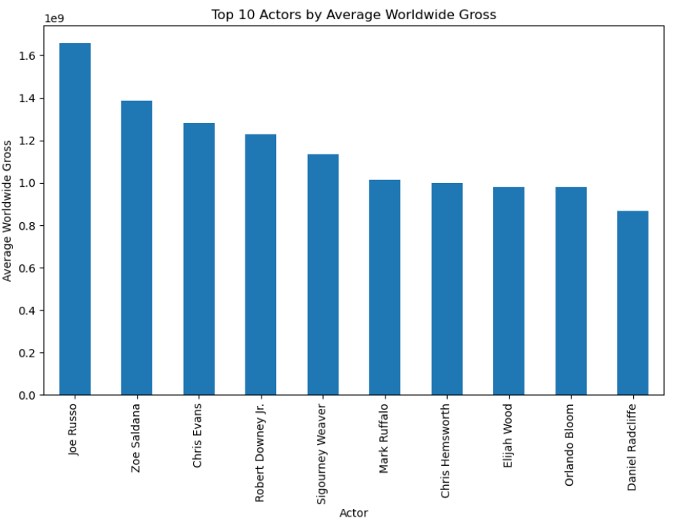
Do certain actors consistently produce higher-grossing films?
Methodology
Univariate Analysis – performed summary statistics (mean, median, count) of each actor who appeared 3 or more times
Visualization – created bar chart depicted top 10 actors in average worldwide gross revenue
Results
Joe Russo – highest mean Worldwide Gross Revenue
Top 10 actors are commonly known for franchises like Marvel, Avatar, etc.

Slide 7
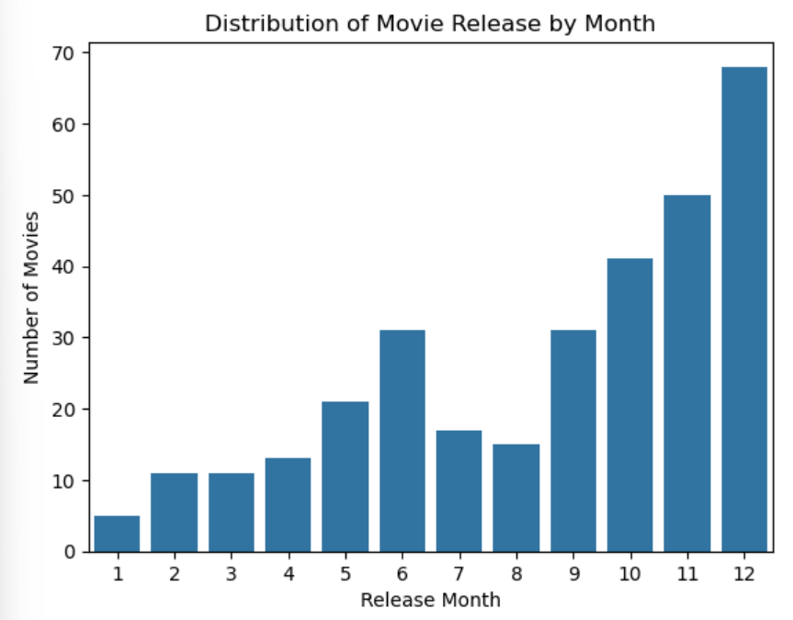
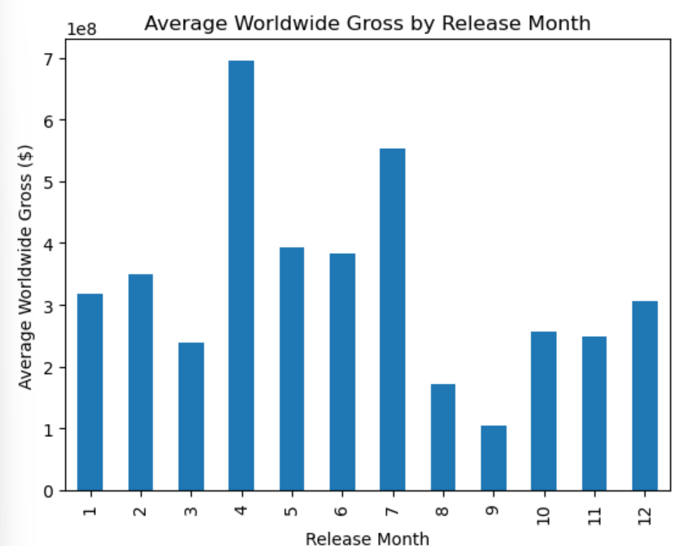
Does release timing affect worldwide gross revenue?
Methodology
Univariate Analysis – plotted the distribution of movie release by month
Bivariate Analysis – plotted relationship between release month and worldwide gross revenue
Conducted hypothesis test – testing whether movies released in summer month perform better than those in non-summer months
Results
Release month distribution is left-skewed, most released in December
Average gross revenue fairly normally distributed, most in April and July
P-Value = 0.0012, less than alpha of 0.05, fail to reject null hypothesis, movies released in summer months outperform those released in non-summer months

Slide 8
Challenges & Questions
Missing Values
Some movies have unknown release dates
Some budget/revenue fields missing, dropped rows if needed
Limited Data
Used dummy variables to fix multi-valued genre column
Actor/Director Analysis
Originally wanted to analyze directorial impact on movie success, not enough repeat directors
Had to pivot to analyzing actors/star power
Other target variables?
Is there any other variables I can predict besides gross revenue?
Other research questions worth analyzing?

Slide 9
Roadmap to Final Project
Add another machine learning model – possibly multiple linear regression finding what most impacts gross revenue
Conduct another hypothesis test – compare gross revenues across genres?
Clean up plots, write final analysis report, deliver clear, impactful results

